Slide 1

Introduction to Validz News
By: IRADUKUNDA Bonté

Slide 2
Introduction
Validz is an agency that is dedicated on giving news and updated ones to people and citizens in the country and the world.

Slide 3


—Someone Famous
There is a saying in Kinyarwanda that says ”Icyambere ni amakuru”

Slide 4
The Problem
The problem of citizens not receiving news, often referred to as the "news deserts" phenomenon, is a growing concern in today's digital age. The absence of news in citizens' lives can lead to a range of negative consequences, including a lack of information, susceptibility to misinformation, reduced civic engagement, and potential threats to democracy and public safety.

Slide 5
The Solution
As Validz after knowing the problem of citizens not receiving news we decided to focus on supporting independent journalism and help more citizens to get news from where they will be so as to reduce the rate of the negative impacts said above in the problem we wanted to solve.

Slide 6
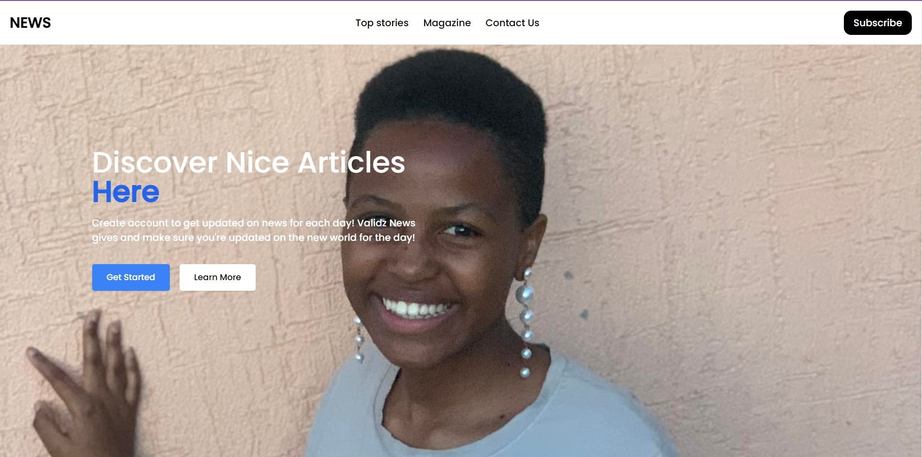
How we do it!
Validz news is developed that a user who wants to get updated news every day he/she has to create an account and subcribe on the website.

Slide 7
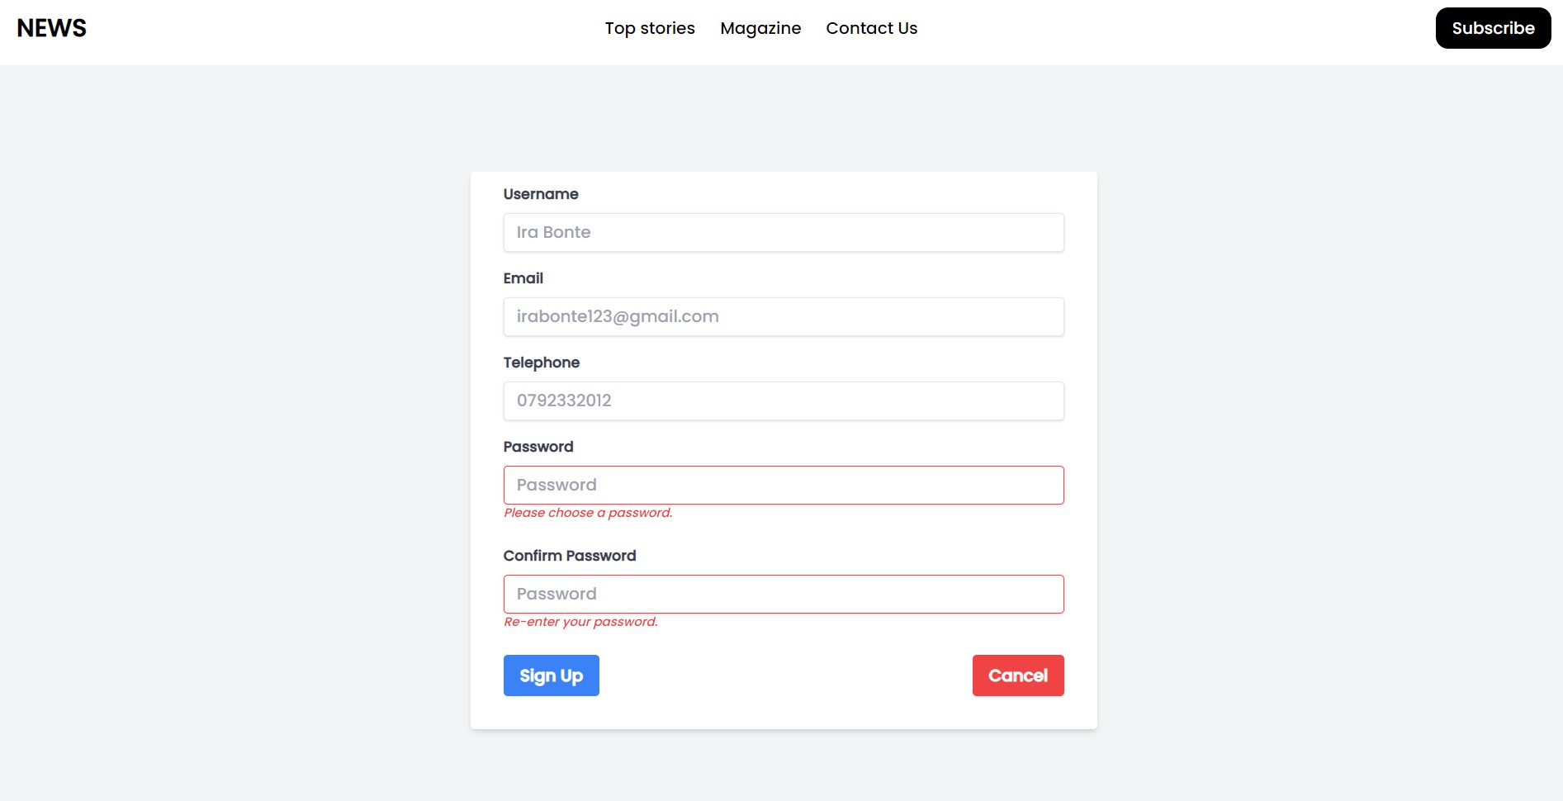
How the user does it
After filling this form you will sign up for reading some news as it will be increasing subscribers and more income and after signing up you can now view some storied that are paid.

Slide 8
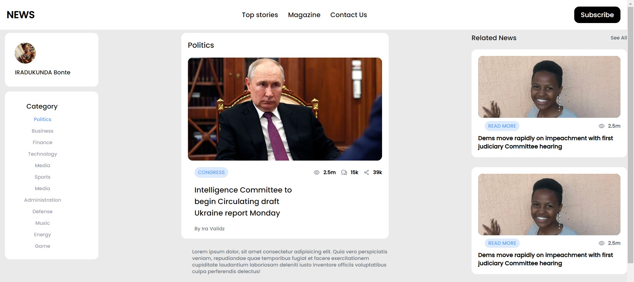
How to do it (…cont)
After getting your account you read the news that required subscription and then you get to be updated on the other daily news.

Slide 9
Our uniqueness
Personalization
We request the user to provide their credentials to have their favorite articles personalized to one’s own interest.
Preferences
We provide numeorous categories so the user might find his favourite or interest in his/her favorite category

Slide 10
2,500,000+
We intend to catch public’s attention up to this numbers of views and more

Slide 11
Time for Demo

Slide 12
Question and Answer
Q & A
.

Slide 13
THANK YOU FOR YOUR ATTENTION!
Much respect!

